Slide 1



WELCOME TO TEG
THANK YOU FOR SHARING YOUR IDEAS AND VISION OF YOUR COMPANY WITH ME, AND GIVING ME THE OPPORTUNITY TO WALK YOU THROUGH HOW WE SEE TEG AS THE PERFECT RESOURCE FOR HELPING YOU LAUNCH YOUR COLLECTION SUCCESSFULLY.

Slide 2
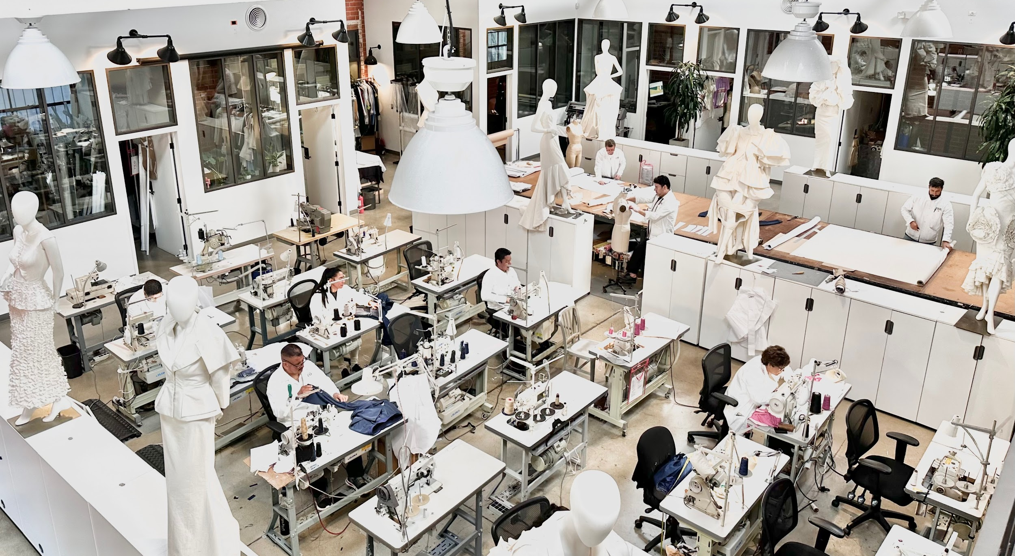
PROPOSAL FOR
1ST NAME 2ND NAME

Slide 3

LAUNCHING A LINE IS HARD. WE MAKE IT EASIER.
TEG IS AN ETHICAL AND FAIR LA-BASED FASHION DEVELOPMENT AND PRODUCTION HOUSE FOUNDED TO SUPPORT EMERGING AND EXPERIENCED HIGH-END DESIGNERS

Slide 4
AGENDA
1ST NAME’S PRIORITIES
YOUR TEG TEAM
HISTORY OF TEG
WHY TEG?
PRICING
NEXT STEPS

Slide 5

PRIORITIES
SOURCE FABRIC & TRIMS EFFECTIVELY
DEVELOP HIGH QUALITY PATTERNS & SAMPLES
PRODUCE A SMALL VOLUME PRODUCTION RUN FOR SALES

Slide 6
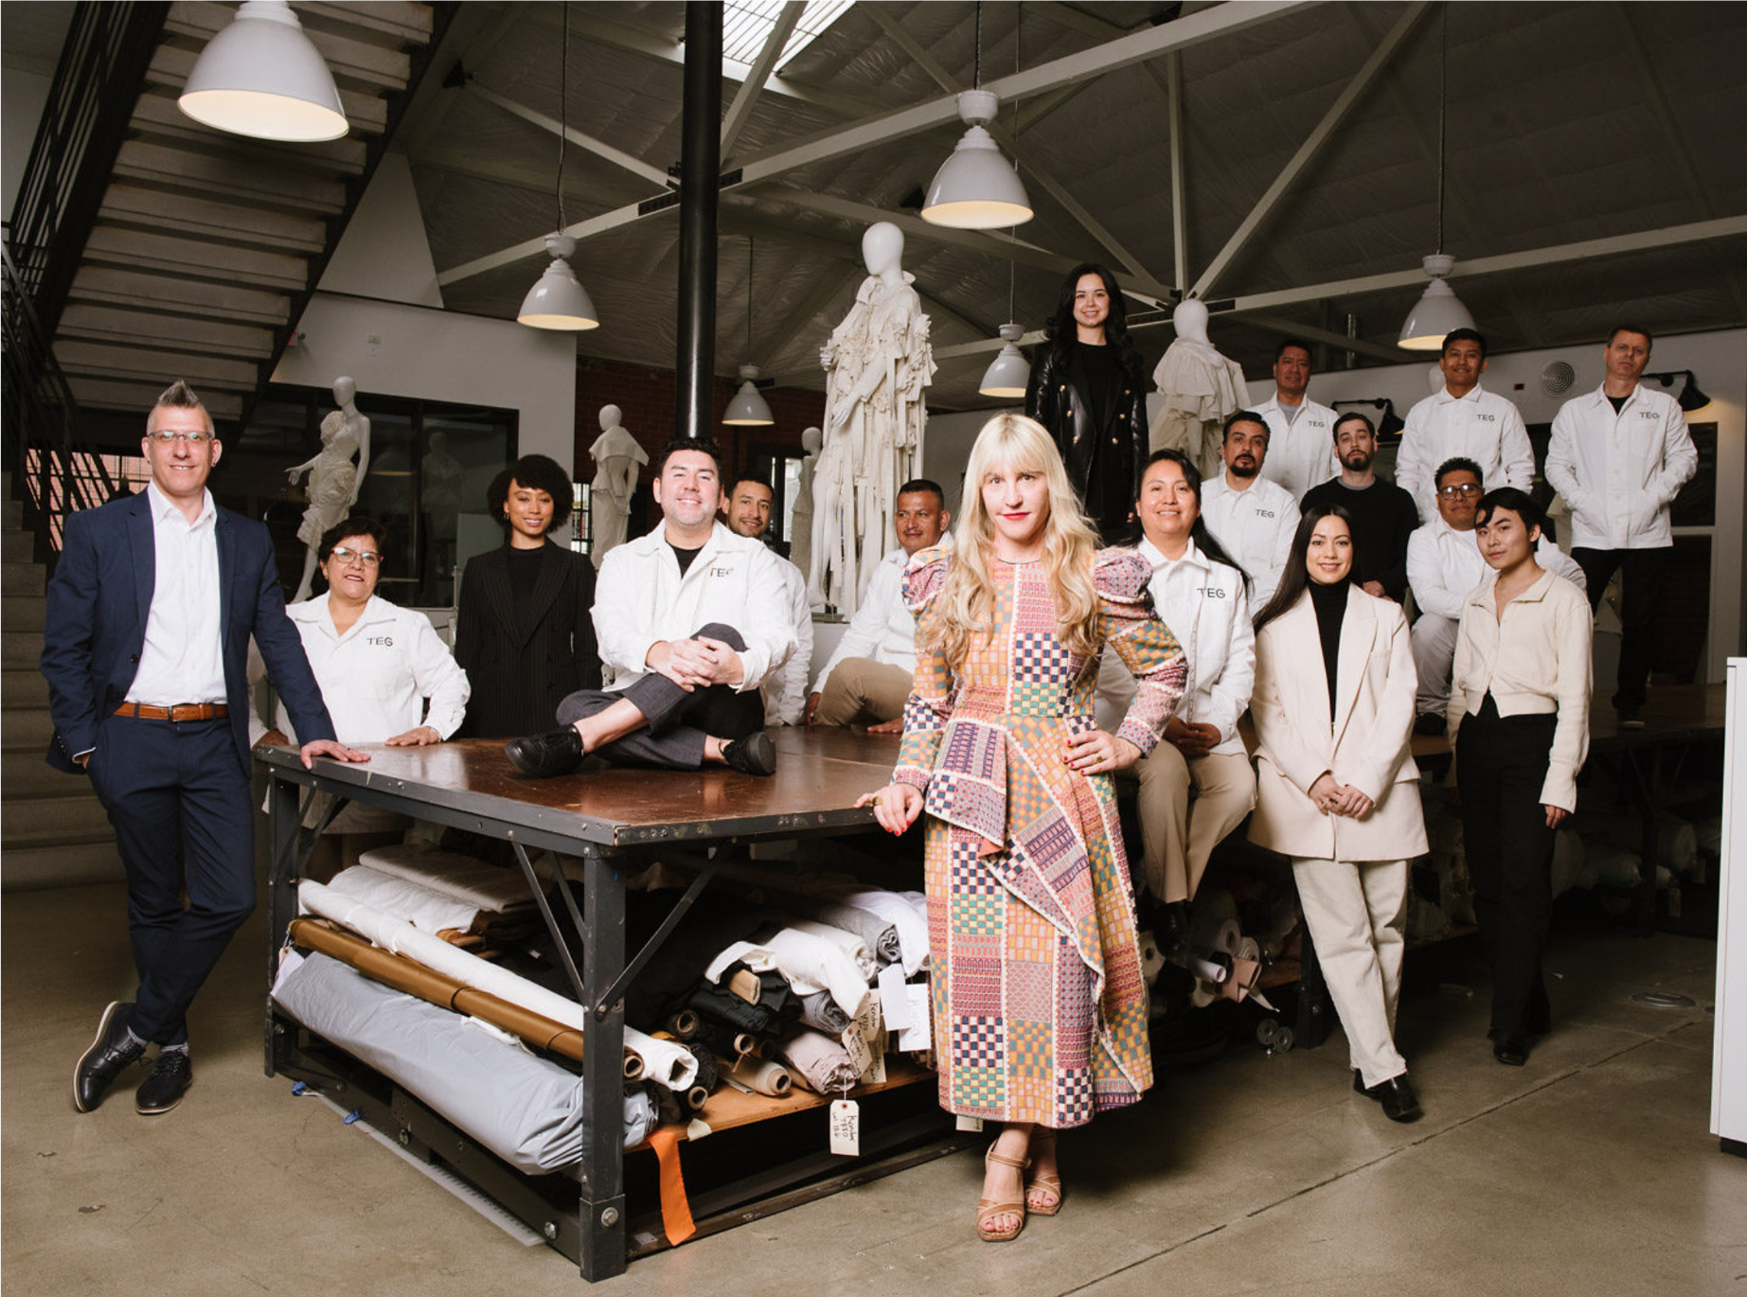
YOUR TEG TEAM

Slide 7
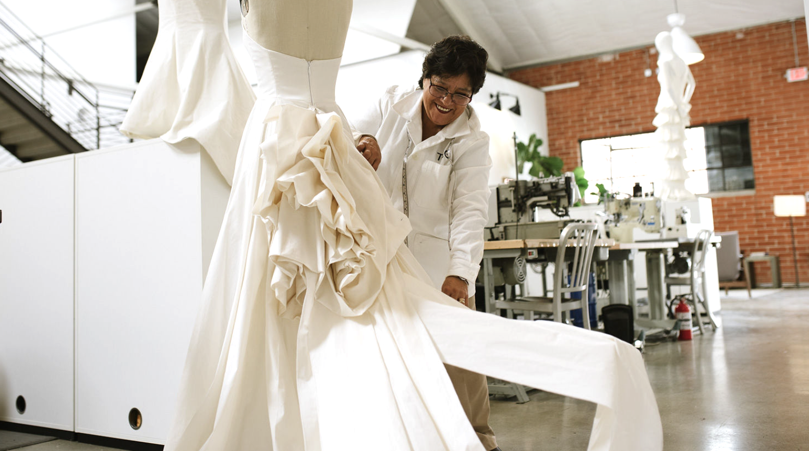

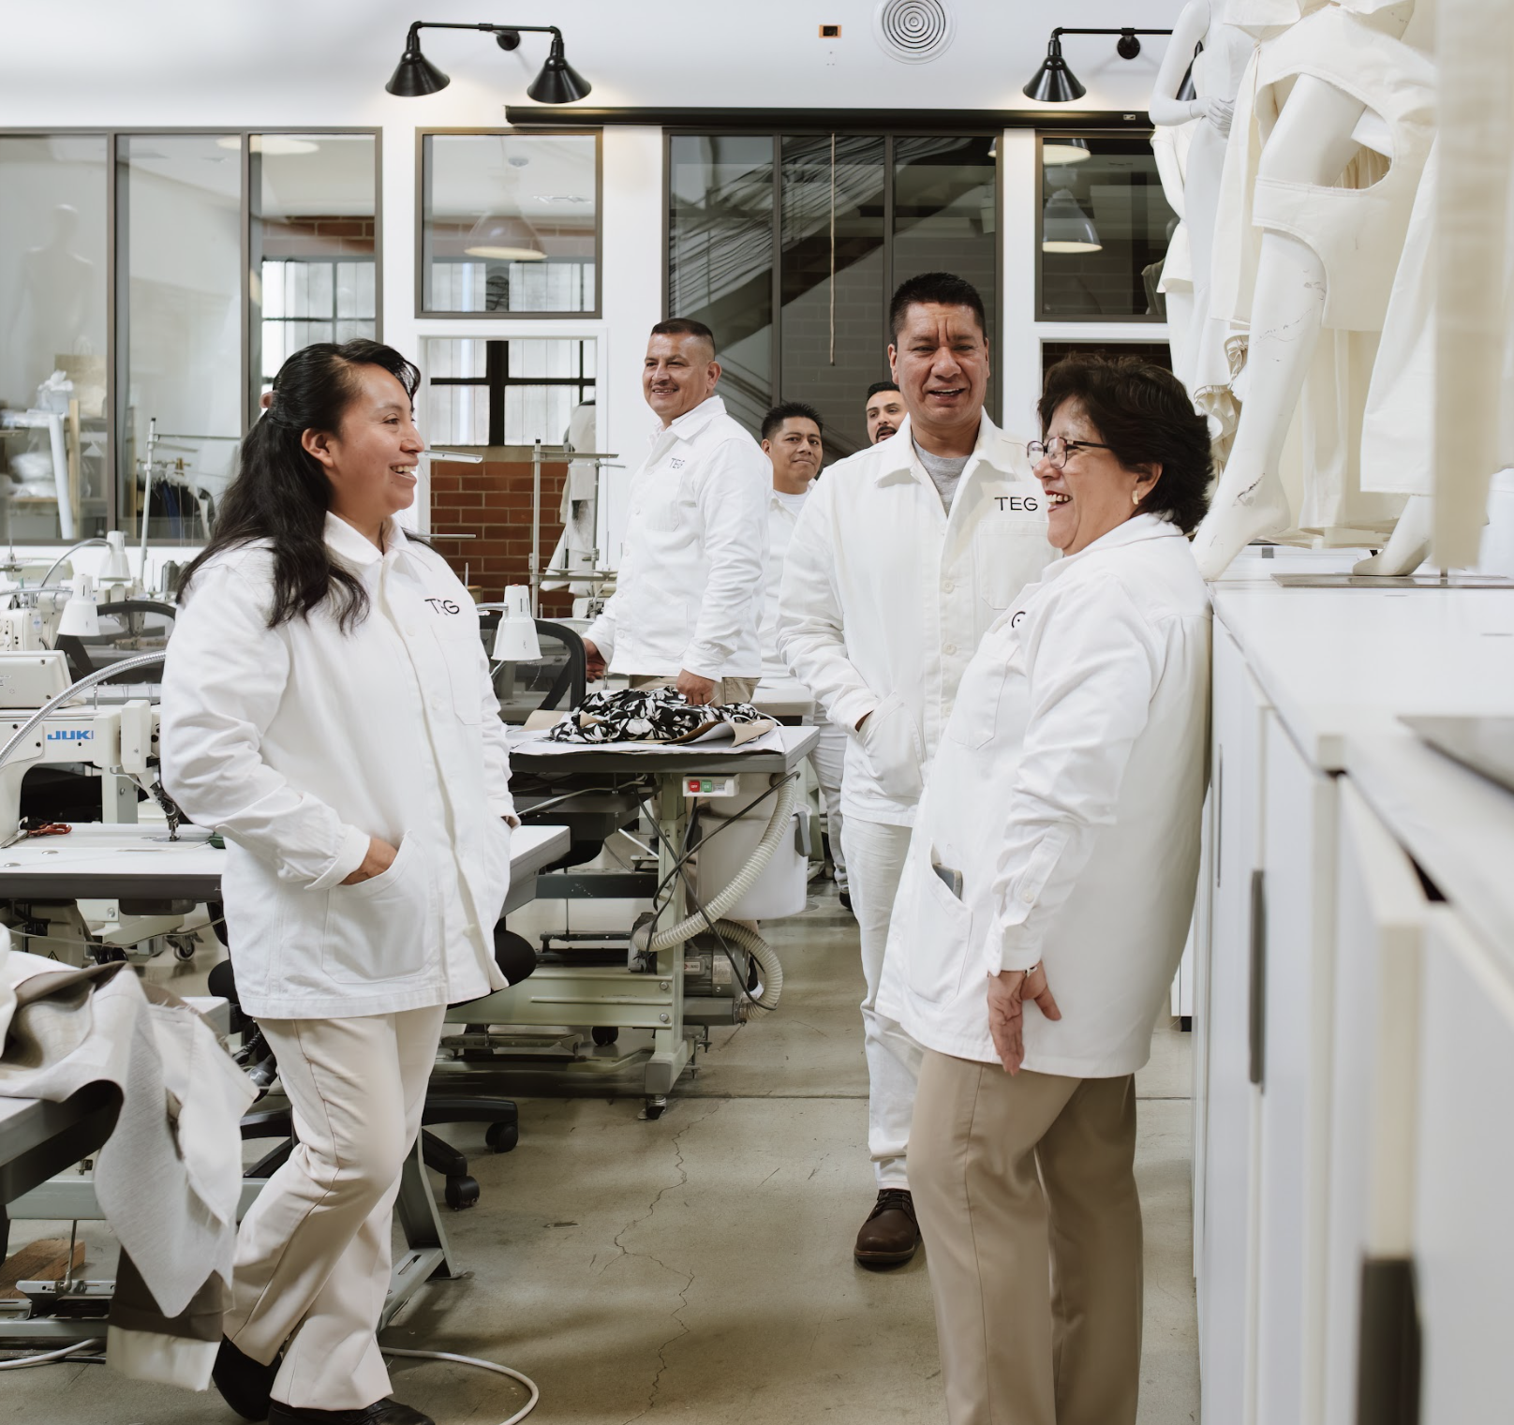

WE PROVIDE WHITE GLOVE, BEST-IN-CLASS SERVICE AT EVERY STAGE OF LAUNCHING YOUR FASHION LINE. WE HANDLE EVERYTHING FROM FABRIC SOURCING TO PATTERN-MAKING TO SEWING THAT LAST STITCH. IF YOU CAN ENVISION IT, WE CAN MAKE IT.
HISTORY
SINCE 2005, TEG HAS DEVELOPED A REPUTATION FOR INTEGRITY AND SUPERIOR DOMESTIC CRAFTSMANSHIP. OUR FOUNDER, JENNIFER EVANS, BUILT THIS BUSINESS ON TWO PILLARS — DOING THE BEST WORK AND BEING
THE BEST PLACE TO WORK.
TEG CREATES JOBS THAT KEEP GARMENT WORKERS EMPLOYED AT A LIVING WAGE ALL YEAR ROUND.
TEG WAS FOUNDED SPECIFICALLY FOR EMERGING DESIGNERS LIKE YOURSELF.
AT THE SAME TIME, TEG CREATES JOBS THAT KEEP GARMENT WORKERS
EMPLOYED AT A LIVING WAGE ALL YEAR ROUND. OUR STANDARDS ARE THE BEST IN THE INDUSTRY, AND THESE VALUES LIVE ON IN EVERY PROJECT WE TAKE ON.

Slide 8

WE PROVIDE WHITE GLOVE, BEST-IN-CLASS SERVICE AT EVERY STAGE OF LAUNCHING YOUR FASHION LINE.
OUR TEAM’S SKILLS HAVE BEEN FINELY TUNED TO PROVIDE THE LEVEL OF EXPERTISE, QUALITY, AND GUIDANCE TO DEVELOP YOUR BRAND.
OUR BUSINESS PRACTICES ARE STRAIGHT-FORWARD, FAIR, AND ETHICAL.
IF YOU CAN ENVISION IT, WE CAN MAKE IT.
WHY TEG?

Slide 9
PROJECT HIGHLIGHT
PLACEHOLDER 1
PLACEHOLDER 2
PLACEHOLDER 3

Slide 11
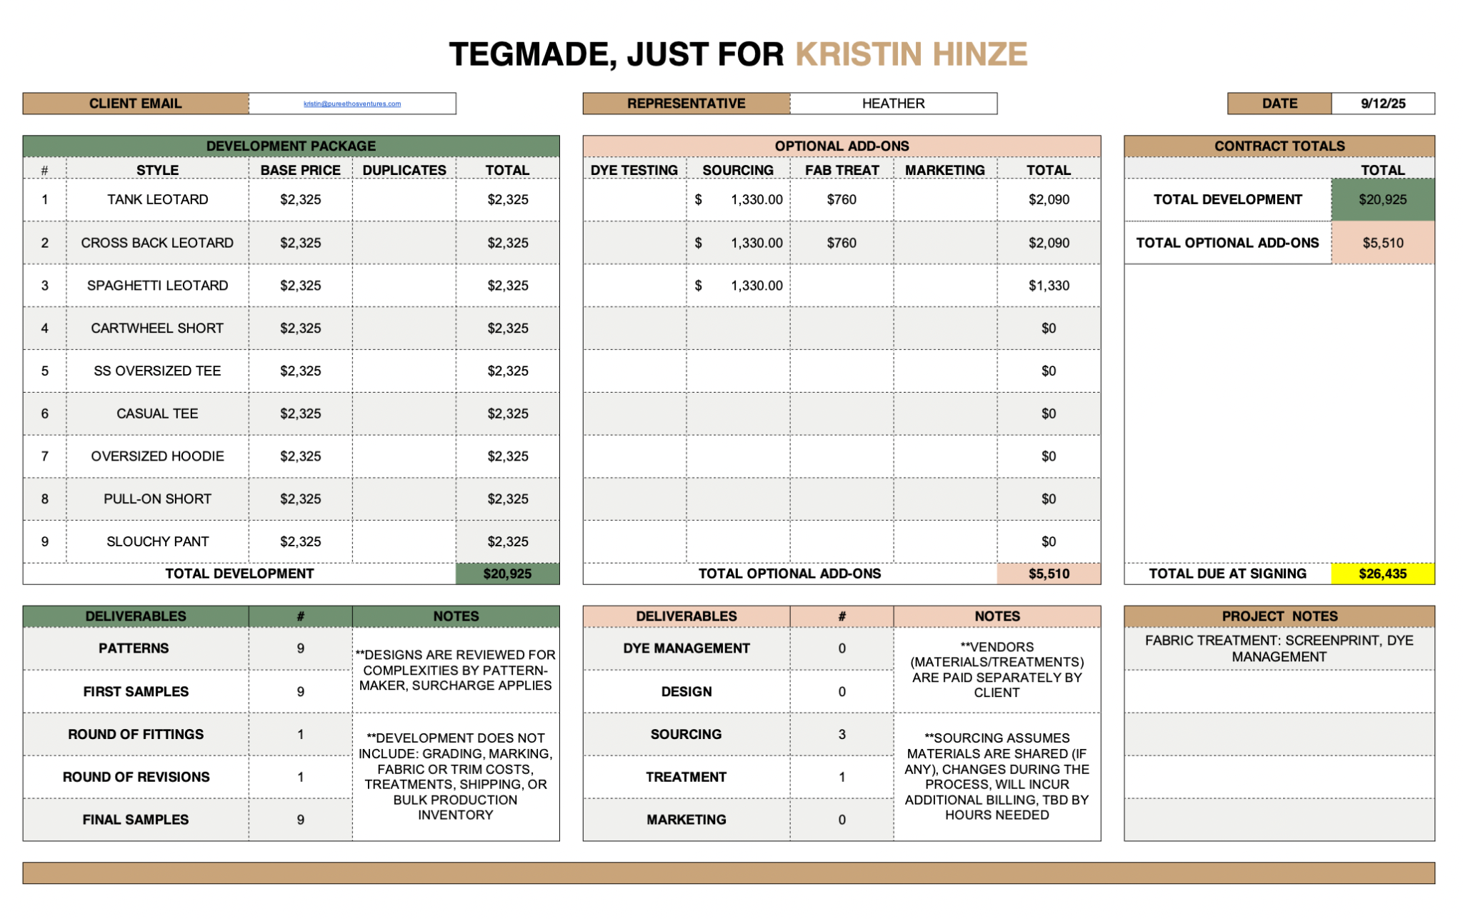

Slide 12

NEXT STEPS WITH TEG
1ST NAME’S APPROVAL OF PROJECT
CONTRACT PRESENTED TO 1ST NAME’S
SIGNED CONTRACT RECEIVED AT TEG
1ST NAME’S ONBOARDING MEETING

